Slide 1

Basic building blocks of Angular 2
Satya Prakash Mishra

Slide 2
Agenda
The Angular 2 Big Picture
Component Fundamentals
Templates
Services
Routing

Slide 3
Why Angular 2?
The new Angular codebase is more modern, more capable and easier for new programmers to learn than Angular 1.x, while also being easier for project veterans to work with.
With Angular 1, programmers had to understand the differences between Controllers, Services, Factories, Providers and other concepts that could be confusing, especially for new programmers.
Angular 2 is a more streamlined framework that allows programmers to focus on simply building JavaScript classes.
Views and controllers are replaced with components, which can be described as a refined version of directives. Even experienced Angular programmers are not always aware of all the capabilities of Angular 1.x directives.
Angular 2 components are considerably easier to read, and their API features less jargon than Angular 1.x's directives.

Slide 4
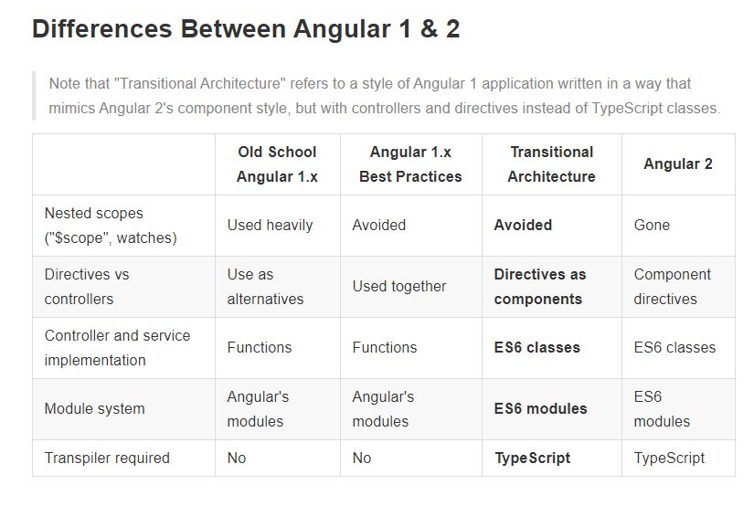

Slide 5
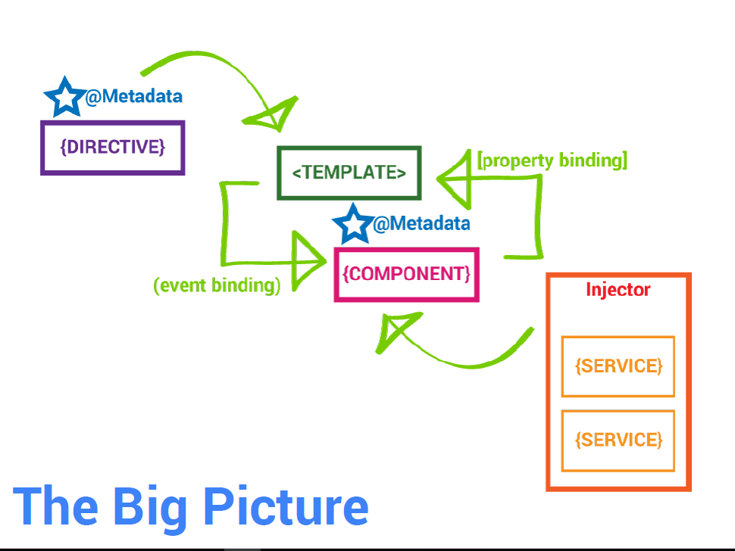

Slide 6
Main Building Blocks of Angular 2
Metadata/Decorator
Module
Component
Template
Data Binding
Service
Directive
Dependency Injection

Slide 7
Decorator/Metadata
Metadata gives basic information about a class.
We can attach metadata with TypeScript using decorators
Decorators are just functions
We turn our class into something Angular 2 can use by decorating it with a Angular specific metadata
Use the @<decorator> syntax to decorate your classes
The most common class decorators are @Component, @NgModule, @Injectable, @Directive
Decorator have config option as well.
You can also decorate properties and methods within your class

Slide 8
Module
In Angular, a module is a mechanism to group components, directives, pipes and services that are related, in such a way that can be combined with other modules to create an application.
Example
import { NgModule } from '@angular/core';
@NgModule({
imports: [ ... ],
declarations: [ ... ],
bootstrap: [ ... ]
})
export class AppModule { }

Slide 9
Component
Components are just ES6 classes
We define a component's application logic inside a class. To this we attach @Component, a TypeScript decorator, which allows you to modify a class or function definition and adds metadata to properties and function arguments.
selector: is the element property that we use to tell Angular to create and insert an instance of this component.
template: is a form of HTML that tells Angular what needs to be to rendered in the DOM.

Slide 10
import { Component } from '@angular/core';
@Component({
selector: 'rio-hello',
template: '<p>Hello, {{name}}!</p>',
})
export class HelloComponent {
name: string;
constructor() {
this.name = 'World';
}
}

Slide 11
Template
A template is HTML that tells Angular how to render a component
Templates include data bindings as well as other components and directives
Angular 2 leverages native DOM events and properties which dramatically reduces the need for a ton of built-in directives

Slide 12
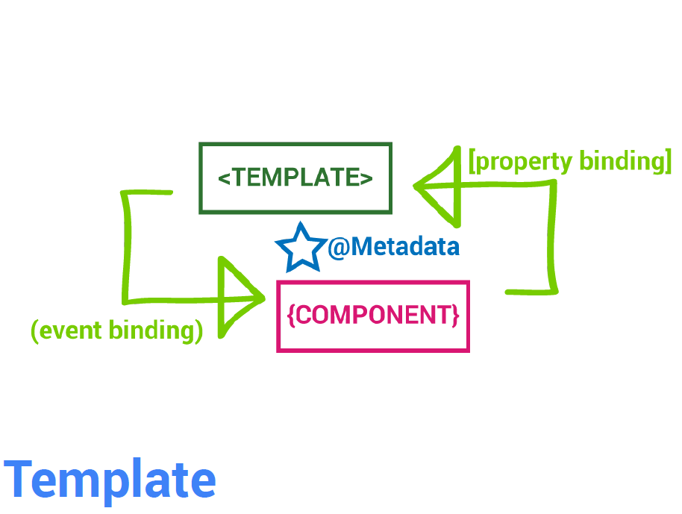

Slide 13
Example
@Component({
selector: 'experiment',
templateUrl: './experiment.detail.component.html',
styles: [`
.experiment {
cursor: pointer;
outline: 1px lightgray solid;
padding: 5px;
margin: 5px;
}
`]
})

Slide 14
@Component({
selector: 'experiment',
template: `<div class="experiment" (click)="doExperiment()">
<h3>{{ experiment.name }}</h3>
<p>{{ experiment.description }}</p>
<p><strong>{{experiment.completed}}</strong></p>
</div>`,
styles: [`
.experiment {
cursor: pointer;
outline: 1px lightgray solid;
padding: 5px;
margin: 5px;
}
`]
})

Slide 15
Data Binding
Enables data to flow from the component to template and vice-versa
Includes interpolation, property binding, event binding, and two-way binding (property binding and event binding combined)
The binding syntax has expanded but the result is a much smaller framework footprint

Slide 16
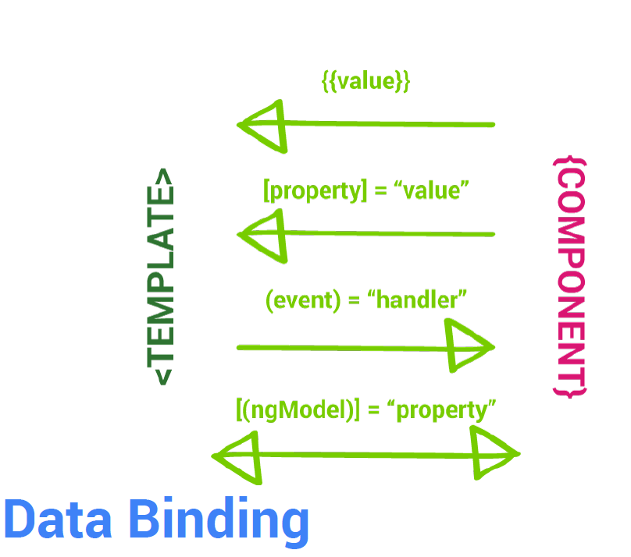

Slide 17
<h1>{{title}}</h1>
<p>{{body}}</p>
<hr/>
<experiment *ngFor="#experiment of experiments"
[experiment]="experiment"></experiment>
<hr/>
<div>
<h2 class="text-error">Experiments: {{message}}</h2>
<form class="form-inline">
<input type="text“ [(ngModel)]="message" placeholder="Message">
<button type="submit" class="btn“ (click)="updateMessage(message)">Update Message</button>
</form>
</div>

Slide 18
Service
A service is just a class
Should only do one specific thing
Take the burden of business logic out of components
Decorate with @Injectable when we need to inject dependencies into our service

Slide 19
import { Http } from '@angular/http';
import { Injectable } from '@angular/core';
import 'rxjs/add/operator/map';
@Injectable()
export class SearchService {
constructor(private http: Http) {}
search(term: string) {
return this.http
.get('https://api.spotify.com/v1/search?q=' + term + '&type=artist')
.map(response => response.json());
}
}

Slide 20
Directive
A Directive modifies the DOM to change appearance, behaviour or layout of DOM elements. Directives are one of the core building blocks Angular uses to build applications.
In fact, Angular components are in large part directives with templates.
A directive is a class decorated with @Directive
There are three main types of directives in Angular:
by affecting Component - directive with a template.
Attribute directives - directives that change the behaviour of a component or element but don't affect the template. Ex-: NgStyle, NgClass
Structural directives - directives that change the behaviour of a component or element of the template is rendered. Ex. *ngFor, *ngIf

Slide 21
Highlight.ts-:
import { Directive, ElementRef } from '@angular/core';
@Directive({
selector: '[appHighlight]'
})
export class HighlightDirective {
constructor(el: ElementRef) {
el.nativeElement.style.backgroundColor = 'yellow';
}
}
Html-:
<p appHighlight>Highlight me!</p>

Slide 22
Router
Routing allows you to:
Maintain the state of the application
Implement modular applications

Slide 23
Configuring Routes
Set a base href in the head tag of your HTML like so:
<base href="/">
Configuration is handled via a decorator function (generally placed next to a component) by passing in an array of route definition objects
Route Definition Object
The Routes type is an array of routes that defines the routing for the application. This is where we can set up the expected paths, the components we want to use and what we want our application to understand them as.
Each route can have different attributes; some of the common attributes are:
path - URL to be shown in the browser when application is on the specific route
component - component to be rendered when the application is on the specific route
redirectTo - redirect route if needed; each route can have either component or redirect attribute defined in the route.
Use the router-outlet directive to tell Angular where you want a route to put its template
<router-outlet></router-outlet>

Slide 24
routeConfig.ts-:
import { RouterModule, Routes } from '@angular/router';
const routes: Routes = [
{ path: 'component-one', component: ComponentOne },
{ path: 'component-two', component: ComponentTwo },
{ path: '**', redirectTo: 'activate.html' }
];
export const routing = RouterModule.forRoot(routes);
In Html-:
<div id="container">
<router-outlet></router-outlet>
</div>

Slide 25
Add a routerLink attribute directive to an anchor tag Bind it to a template expression that returns an array of route link parameters <a [routerLink]="['Users']">Users</a>
Navigate imperatively by importing Router, injecting it, and then calling .navigate() from within a component method
We pass the same array of parameters as we would to the routerLink directive this._router.navigate( ['Users'] );
Example-:
<div id="menu">
<a [routerLink]="['/Home']" class="btn">Home</a>
<a [routerLink]="['/About']" class="btn">About</a>
<a [routerLink]="['/Experiments']" class="btn">Experiments</a>
</div>

Slide 26
Thanks Open for Q/A?

